Slide 1

Welcome to Loni’s Flashcards
The project's purpose is to create an single page application.
The application will give the user the following functionalities:
Create and Delete Flash cards
Answer the Questions of the flashcards
Get an Acceptance Rate based on Yes and No answers

Slide 2
Team members:
Peter Koev - peter.v.koev@gmail.com
Georgi Yordanov - aaster23@protonmail.com
Danail Kirilov - vaitlspaak@gmail.com

Slide 3
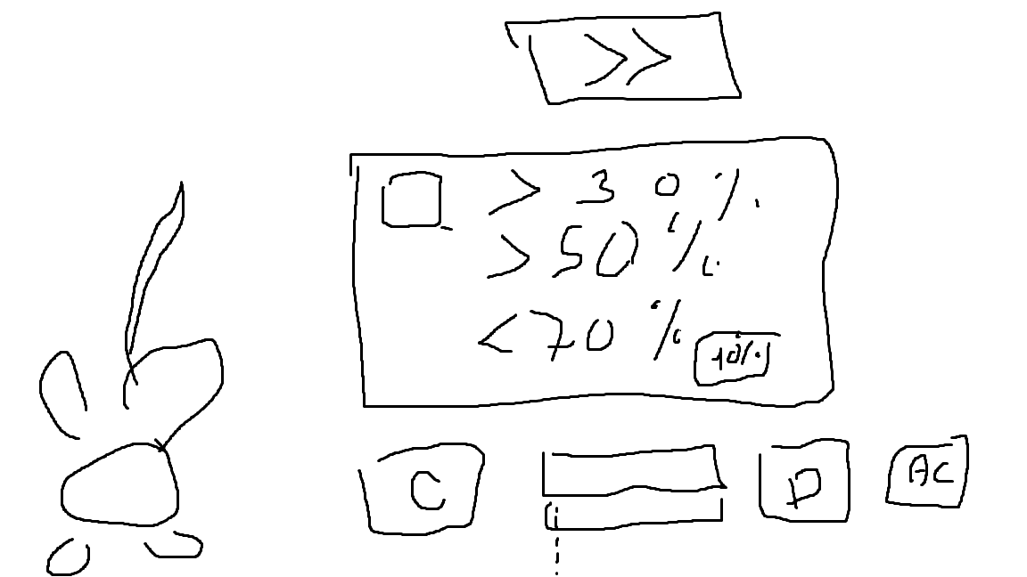
Initial idea:

Slide 4
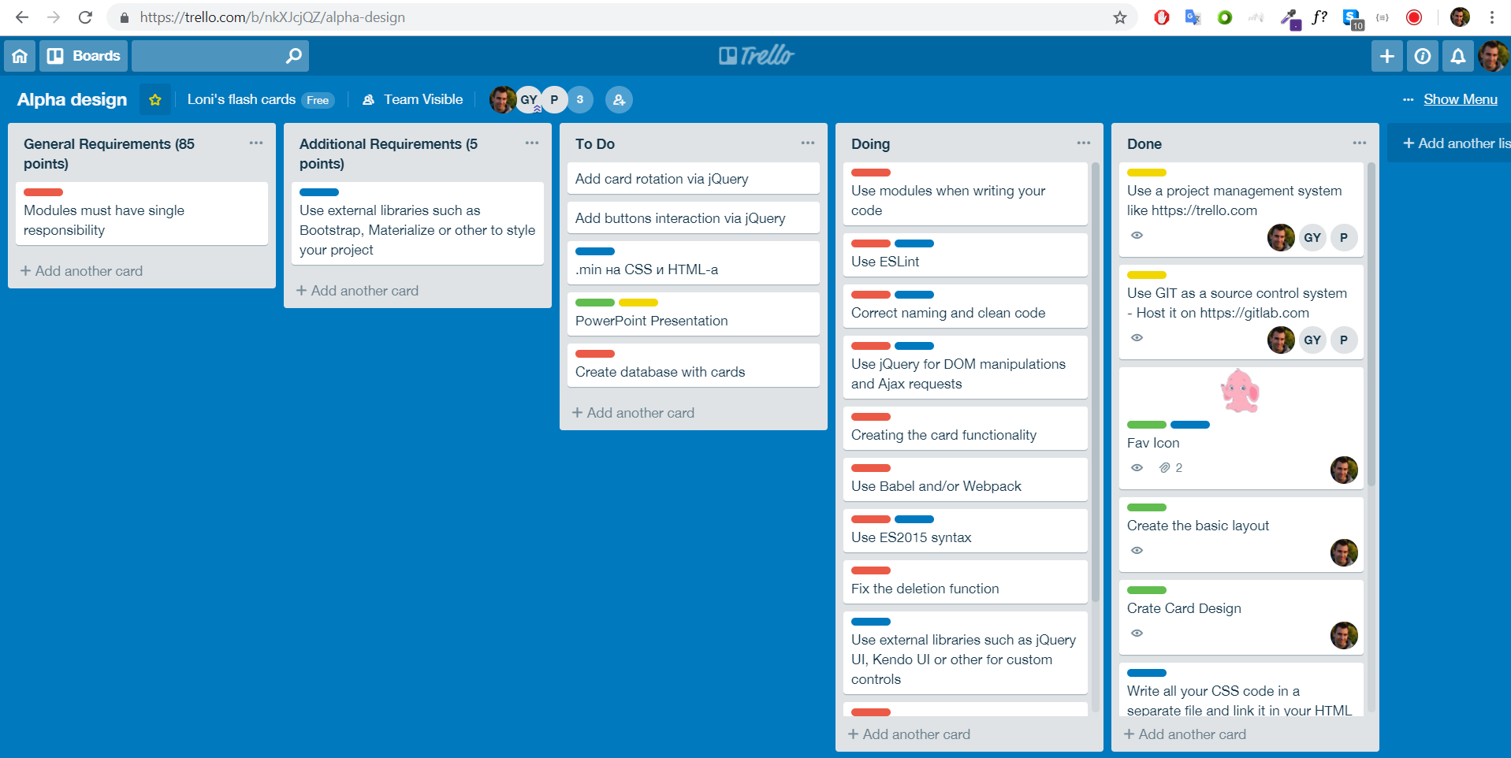
Trello board:

Slide 5
Functionalities:
Add a new flash card
Have no duplicate flash
Delete the current flash card
Answering questions with "I answered" - "I didn't"
Buttons result in change of the Answers Rate 50%, 75%, 100% borders
Play - Stop audio
Store the cards in the local storage, so when you open your browser next time, your cards are still there!

Slide 6
Link to Gitlab:
https:/gitlab.com/aaster23/lonis-flashcards

Slide 7


